Slide 1
Jerry Uelsmann Research assignment
By: Bren Engel

Slide 2
Born June 11, 1934
Born in Detroit
Still living, he currently resides in Gainesville, Florida
Used film to take his pictures
Favorite subject matter is nature
Interested in photography in high school then went to Rochester Institute for photography. First photograph in Photography Annual
Used a darkroom to create photos
House tree and hands picture
He changed the way people made photos
Jerry Uelsmann

Slide 3
Reference Slide
http://www.uelsmann.net/about.php
http://bermangraphics.com/press/jerry-uelsmann.htm
http://biography.yourdictionary.com/jerry-uelsmann
http://www.uelsmann.net/works.php

Slide 4
Voyager, 2008

Slide 5
Forgotten promise, 2012

Slide 6
Journey into night, 2006

Slide 7
Tree-goddess, 1994

Slide 8
Personal Reflection
I have chosen to do my research assignment on Jerry Uelsmann. I chosen to do my project on him because his photos were interesting and unique.. His photographs are very unique and seem to be more futuristic than other photos from his time period. His style is very different than others because he uses nature as his subject matter and then uses a dark room to create his photos.

Slide 9
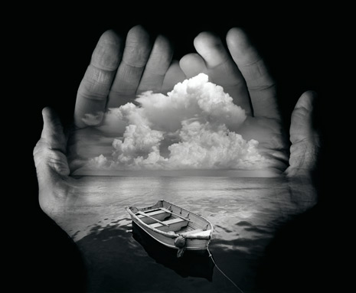
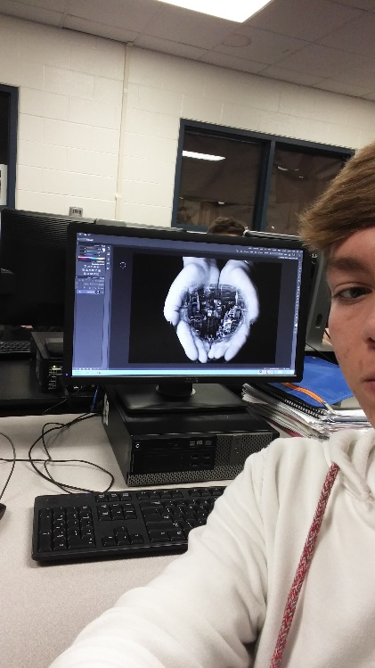
Photo Recreation #1
Untitled – Jerry Uelsmann
Jerry Uelsmann photo recreation

Slide 10
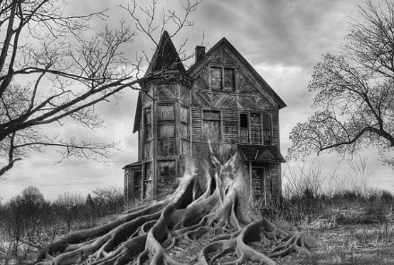
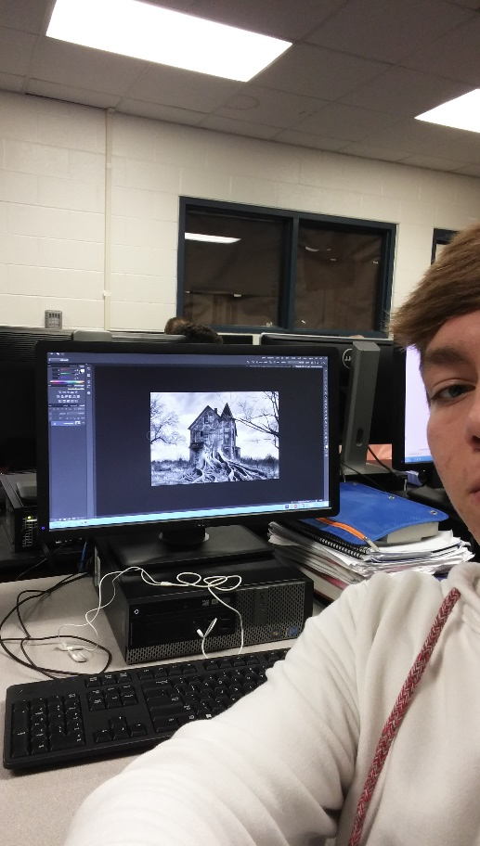
Photo recreation #2
Untitled – Jerry Uelsmann
Jerry Uelsmann photo recreation

